Slide 1
Predicting Bank Churns
Classification via clusterization

Slide 2
Exploratory Data Analysis
Clustering – packing less important features into clusters
Merging clusters and important features
Classyfication – on new merged dataset
Feature Selection

Slide 3
Exploratory Data Analysis

Slide 4
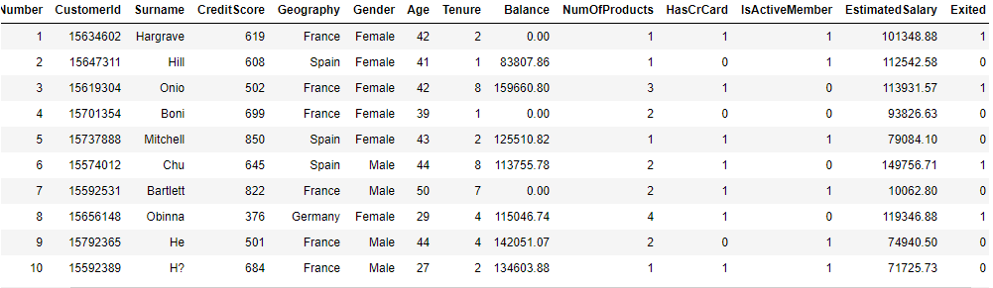


Data Set
Columns to drop: Number, CustomerId, Surname
Columns to clean: Geography, Gender
Scaling might be needed
Balancing the data needed
https://www.kaggle.com/shrutimechlearn/churn-modelling

Slide 5
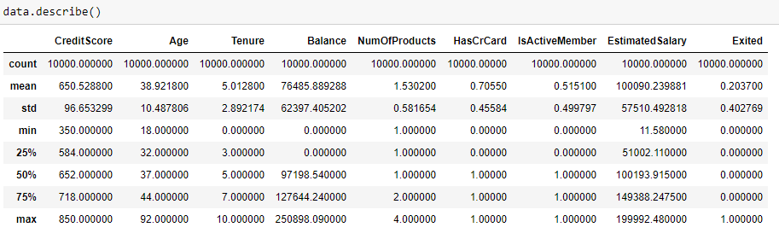
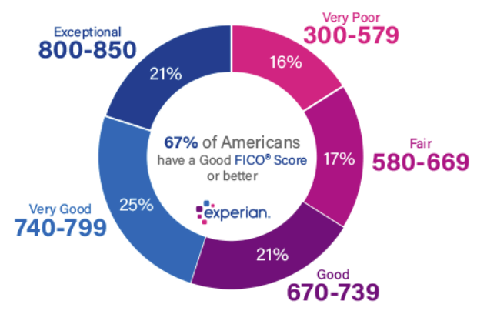
Data Set
Credit Scores Do Not Consider the Following Information:
- race, color, religion, national origin, sex or marital status
- age
- salary, occupation, title, employer, employment history
- address
Credit score: Range 300-850, >700 is good, mean 600-750 (payment history, amounts of other credits, etc.)
Age: 18-92
Tenure: max 10 years

Slide 6
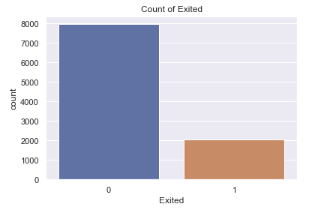
Data Set

Slide 7
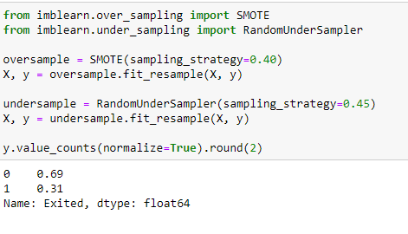
Balancing the data
Oversampling (SMOTE)
Undersampling (RandomUnderSampler)

Slide 8
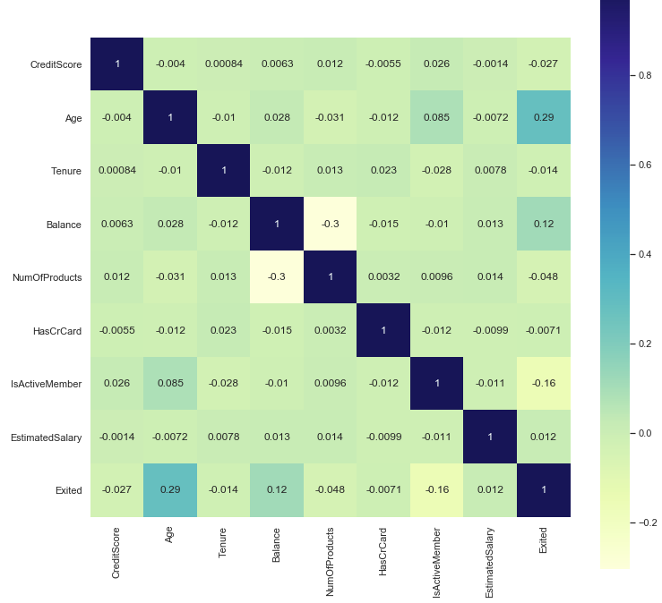
Data Set

Slide 9
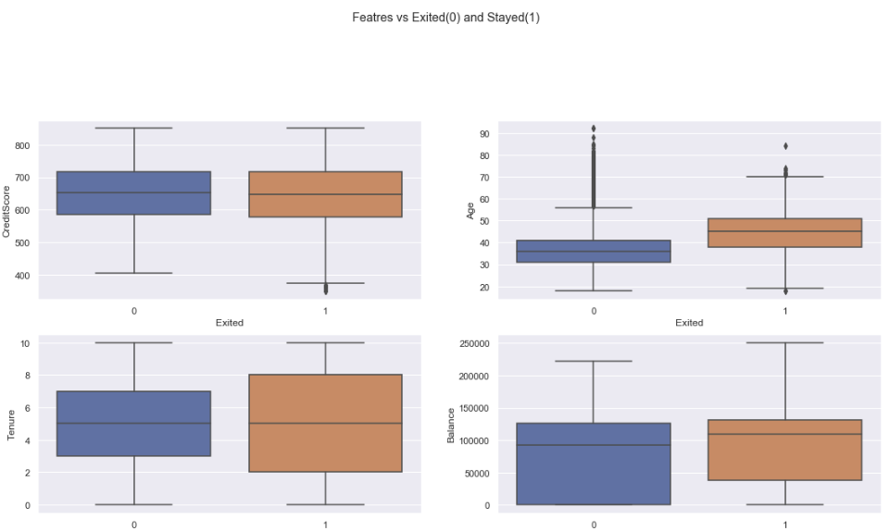
Features impact
Exited (0)
Stayed (1)

Slide 10
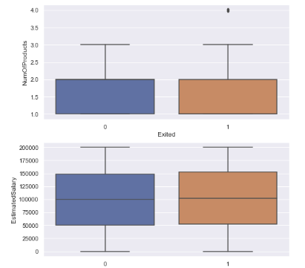
Features impact

Slide 11
Feature Selection & Preprocessing Data

Slide 12


Important Features Selection
Mix of numerical and non-numerical
Categorical
Dummies
Balanced/imbalanced data
Kbest with chi2 selector:
RFE:
Selected Features:

Slide 13
Unsupervised Modelling

Slide 14
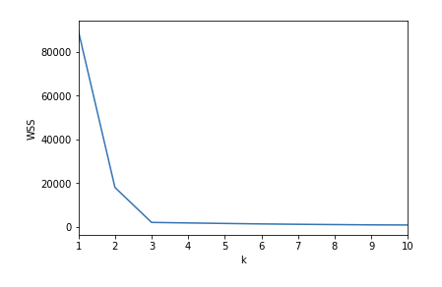
Determining the optimal k for Kmeans Model
The Elbow Method
Calculate the Within-Cluster-Sum of Squared Errors (WSS) for different values of k, and choose the k for which WSS becomes first starts to diminish. In the plot of WSS-versus-k, this is visible as an elbow.
Within-Cluster-Sum of Squared Errors sounds a bit complex. Let’s break it down:
The Squared Error for each point is the square of the distance of the point from its representation i.e. its predicted cluster center.
The WSS score is the sum of these Squared Errors for all the points.
Any distance metric like the Euclidean Distance or the Manhattan Distance can be used.

Slide 15
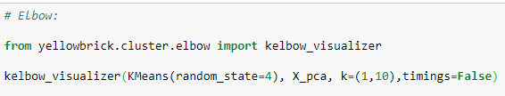
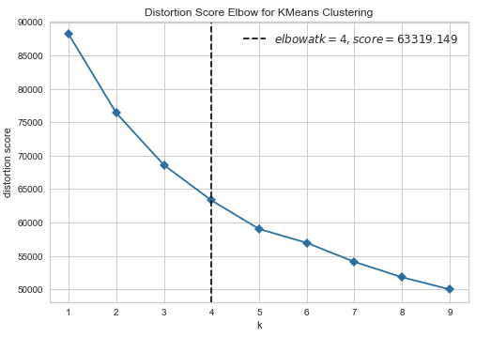
Determining the optimal k for Kmeans Model
Kelbow_visualizer suggest k=4, however the line seems to have no real elbow, data might have no clusters.

Slide 16
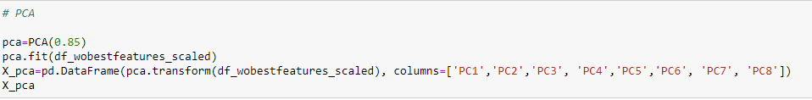
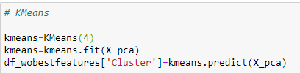
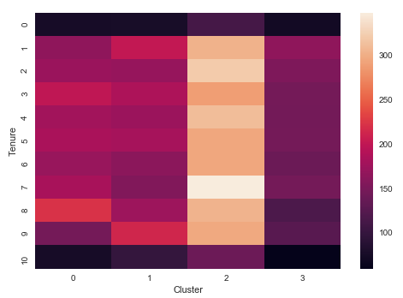
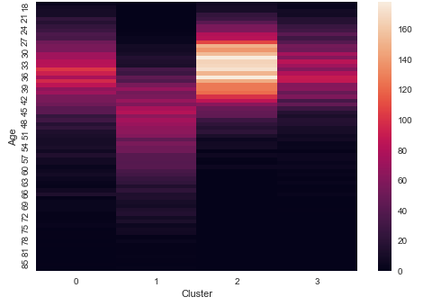
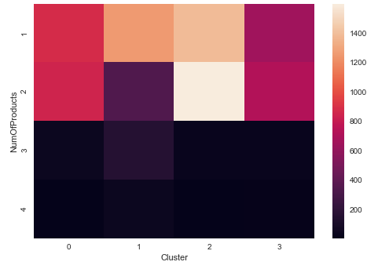
Clustering with Kmeans (PCA applied) and k=4

Slide 17
Supervised Modelling

Slide 18
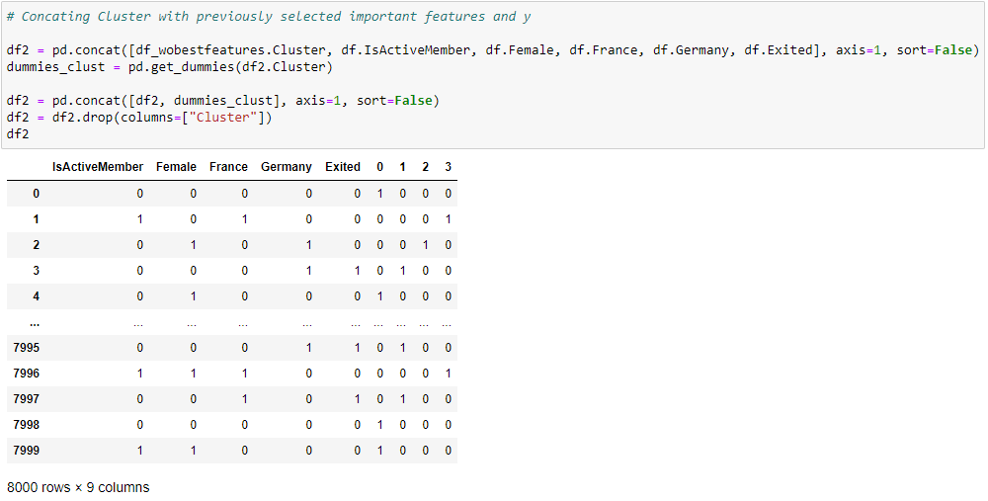
Preprocessing for classification modelling
Concating cluster column and previously selected features.

Slide 19
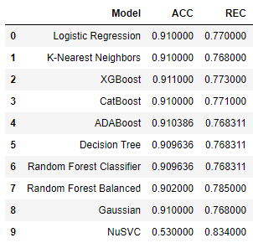
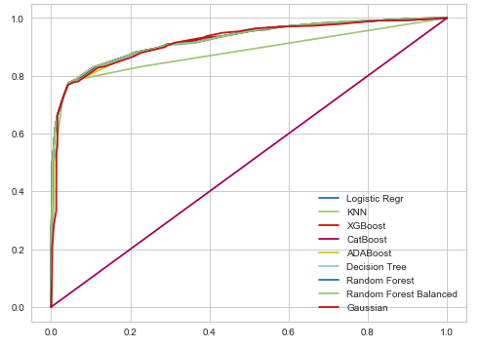
Classification Models Results
Important statistics: Accuracy and Recall
My goal is to find all the clients that might churn
I want to minimize FN (clients who churn without me knowing it before), therefore I want to maximize Recall score

